Slide 1


Slide 2
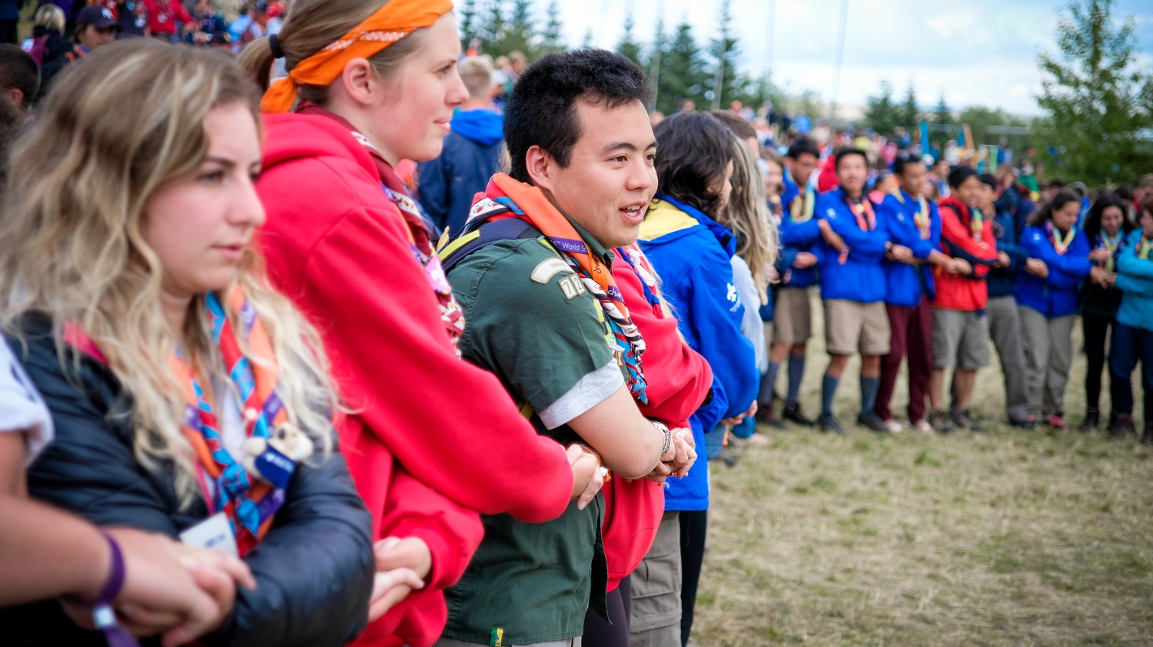

World Scout Youth
involvement Policy
YOUTH PROGRAMME

Slide 3

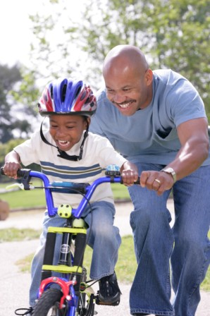
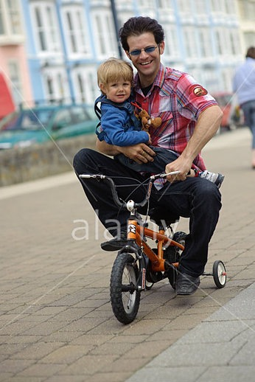
A
B
How to make
young people
learn to be Involved …
A or B?
Notes:
Which picture is representing how we should make young people learn how to be Involved?

Slide 4
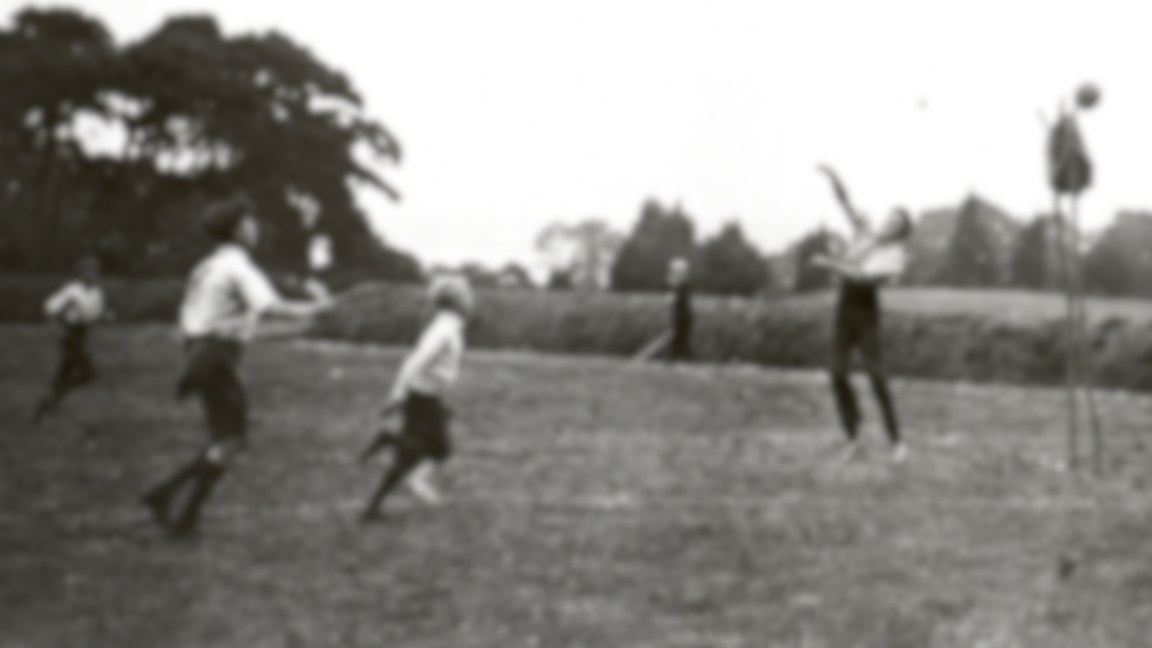
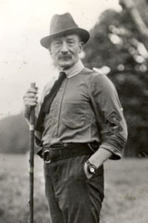

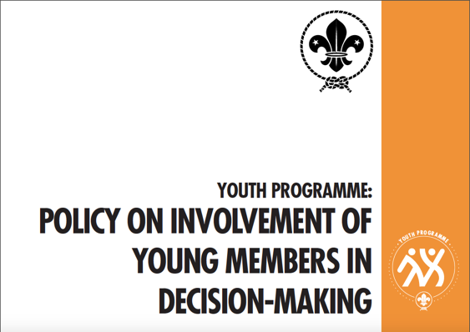

Slide 5
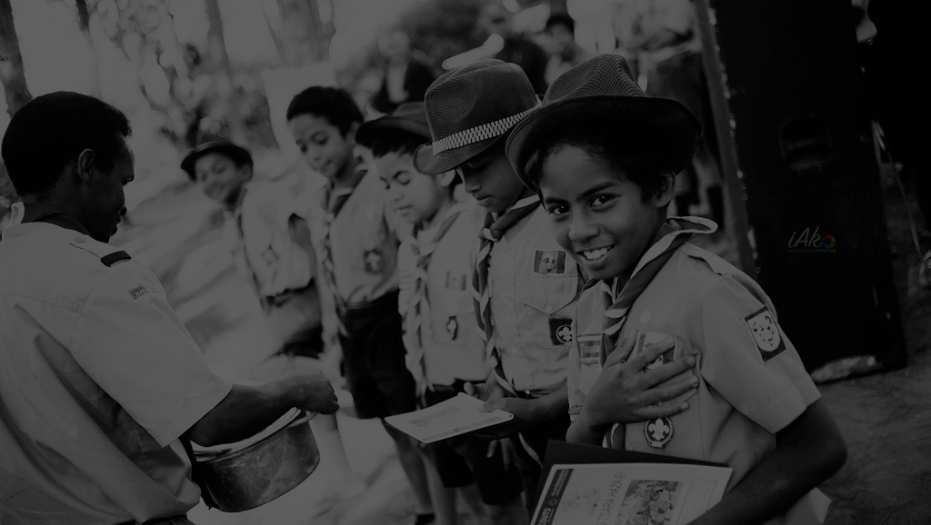
Scouting is a Movement of young people, supported by adults; it is NOT a Movement for young people managed by adults only.
Thus, Scouting offers the potential for a learning community of young people and adults, working together in a partnership of enthusiasm and experience.
The Basic
Principle

Slide 6

What is youth involvement?
Youth
Youth Participation
Youth Involvement
Youth Engagement
Youth Empowerment

Slide 7

is the meaningful participation and sustained involvement of young people in an action in which they use their time, intelligence, talents, skills and abilities for making a positive change in their own and the life of others, which results from strong connections to a particular idea, person, activity, place or outcome.
Youth
Participation
is the attitudinal, structural, and cultural process whereby young people gain the ability, authority, and agency to make decisions and implement change in their own lives and the lives of other people, including young people and adults.
is a capacity-building process, based on enabling young people to actively share responsibility with adults for making decisions that affect their lives, and the lives of others in their community.
is a process that ensures young people
are consulted and given the opportunity
to contribute to the decisions
that affect their lives.
Youth
Involvement
Youth
Engagement
Youth
Empowerment

Slide 8

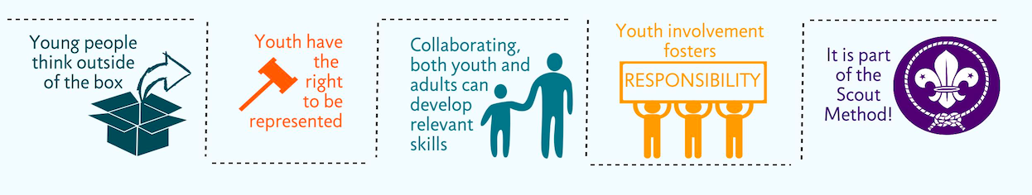

Why involve young people?
Responsibility
Young people think outside of the box
Youth have the right to be represented
Collaborating, both youth and adults can develop relevant skills
Youth involvement fosters Responsibility
It is part of the Scout Method

Slide 9
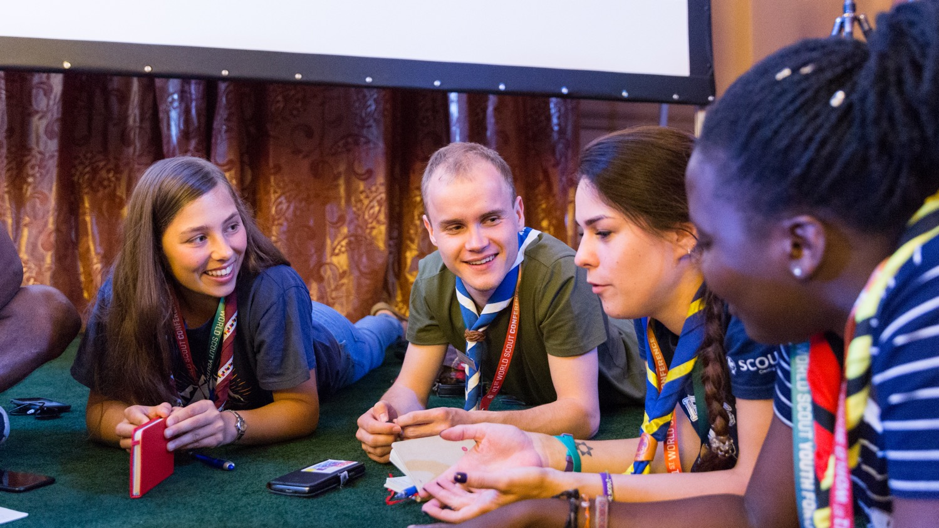
How to involve young people?
Community
level
Unit
level
Institutional
level

Slide 10
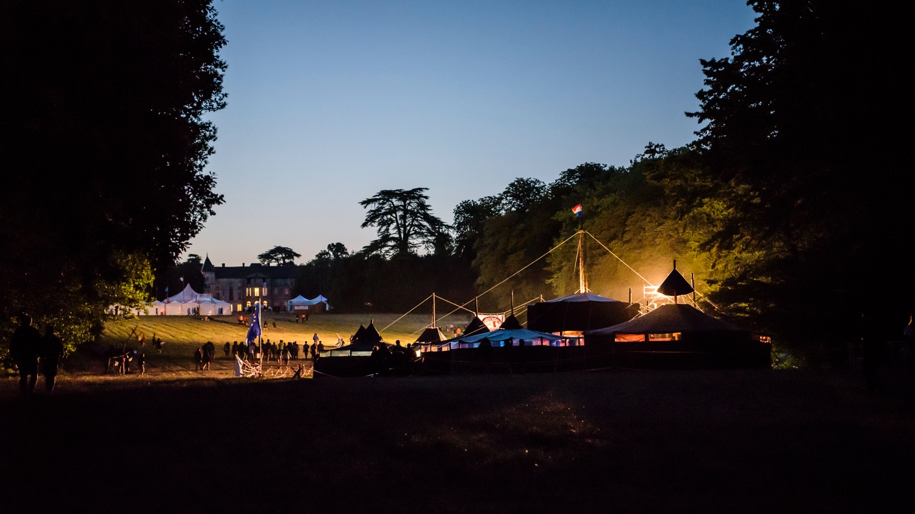
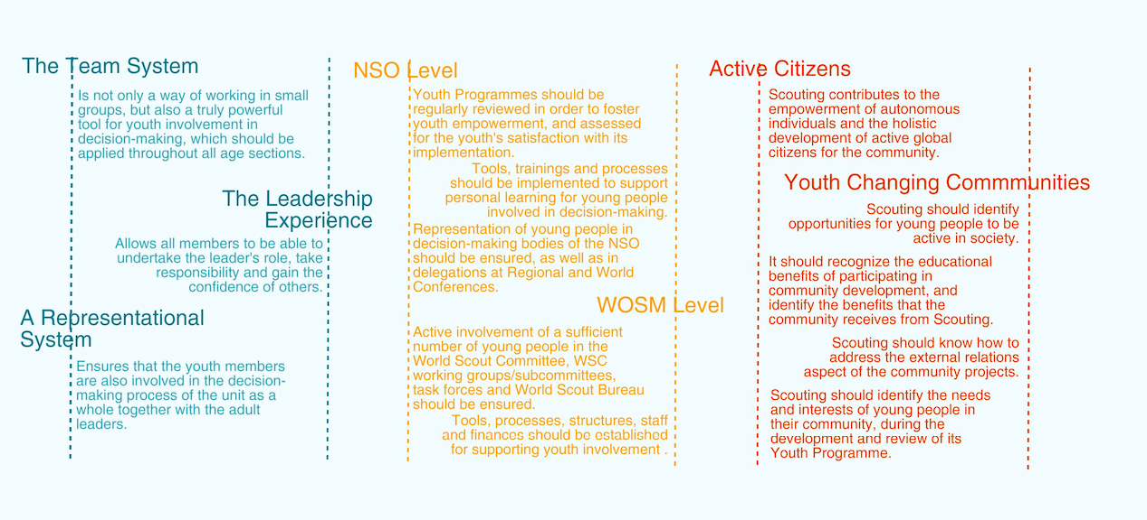

Slide 11
How to involve young people?
The Team System
The Leadership Experience
A representational System
Unit
level
Institutional
level
NSO level
WOSM level
Active Citizens
Youth changing communities
Community
level

Slide 12

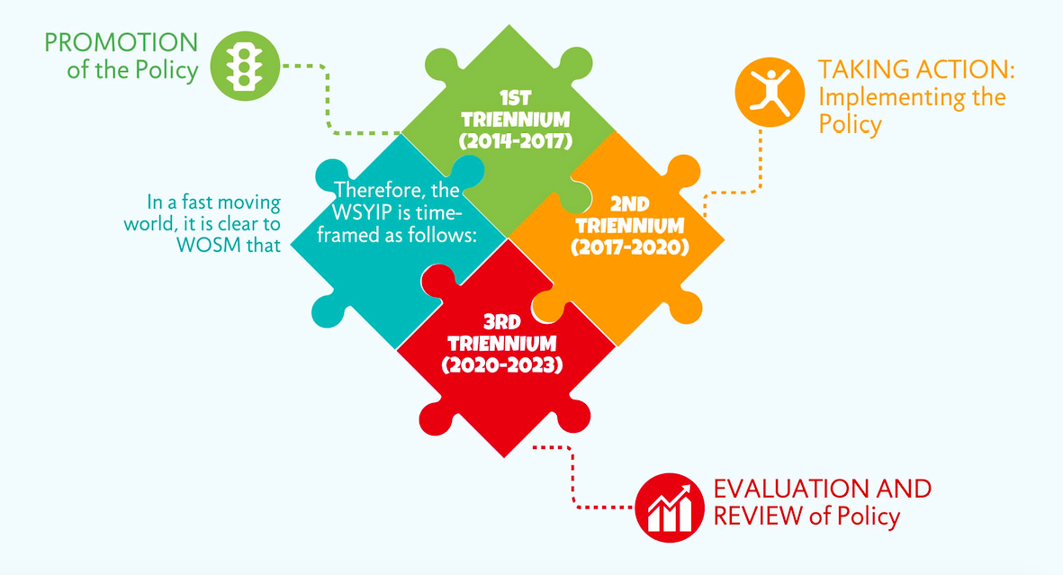
Policy life-cycle
Taking action:
Implementing the Policy
Promotion
Of the Policy
1st
triennium
(2014-2017)
2nd
triennium
(2017-2020)
Evaluation
and review of Policy
3rd
triennium
(2020-2023)

Slide 13
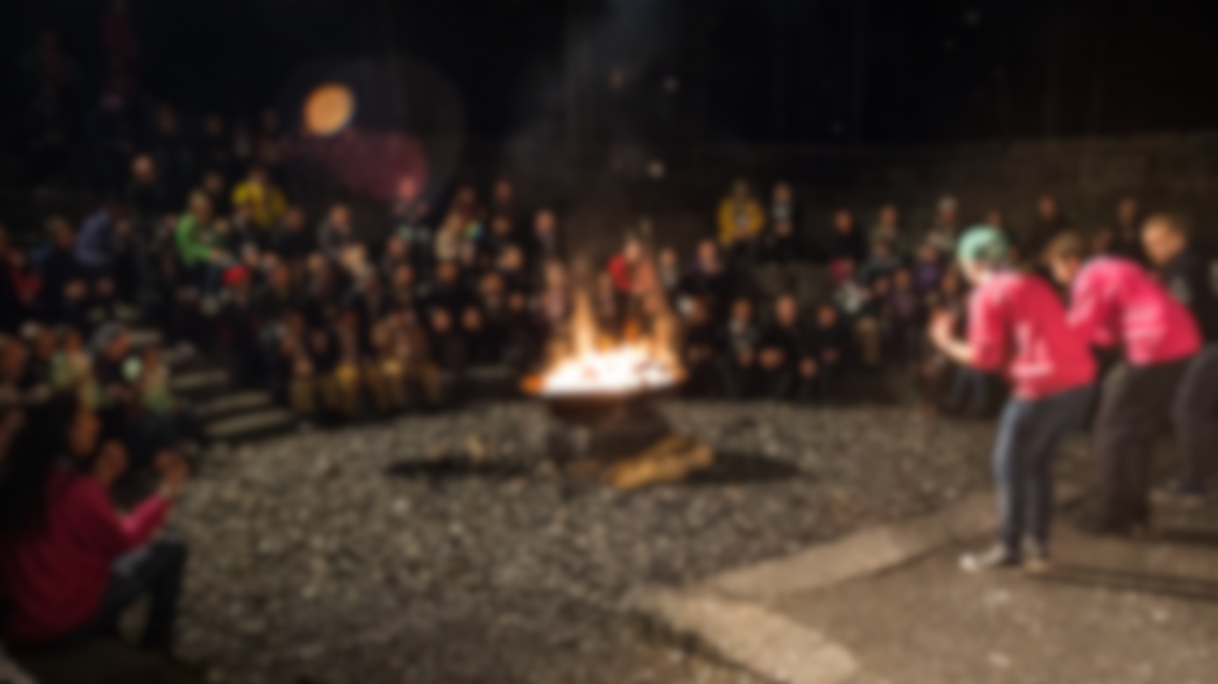

Annexes
Adam Fletcher’s Spiral of Youth Action

Slide 14

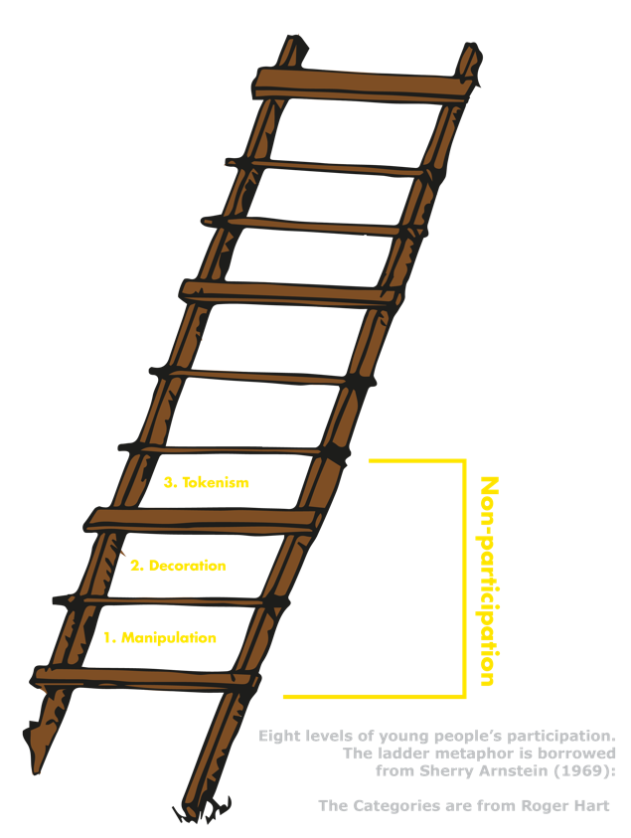
Annexes
The Ladder of Young People’s Participation, developed by Roger Hart

Slide 15
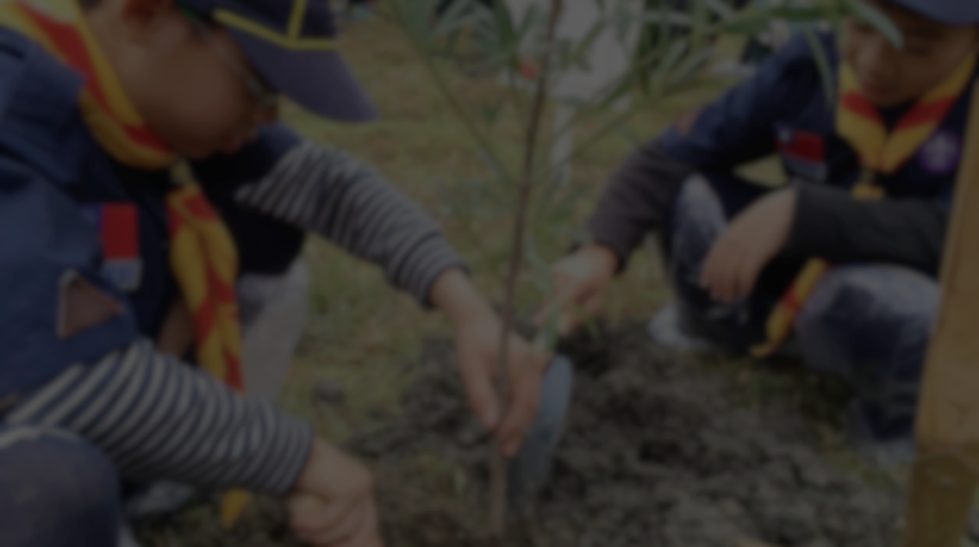
Annexes
The framework for the strategy for Youth Involvement sets out the results which will help NSOs to improve the educational opportunities available to young people in Scouting. These results cover four topics:
Policies and Structures
Programme Support
Communications
Attitudes
The Framework for a Strategy on Youth Involvement, with indicators of success to be achieved by 2020

Slide 16
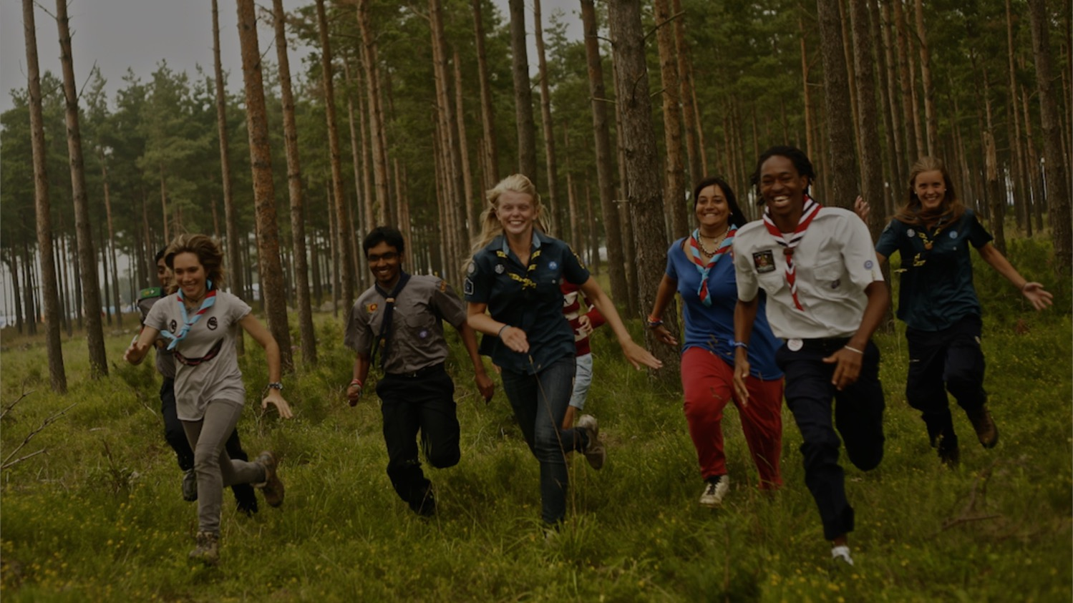
50 MILLION SCOUTS
IN OVER 220 COUNTRIES
AND TERRITORIES
ARE CREATING
A BETTER WORLD…
Thank You

